Slide 1

Unit 14

Slide 2
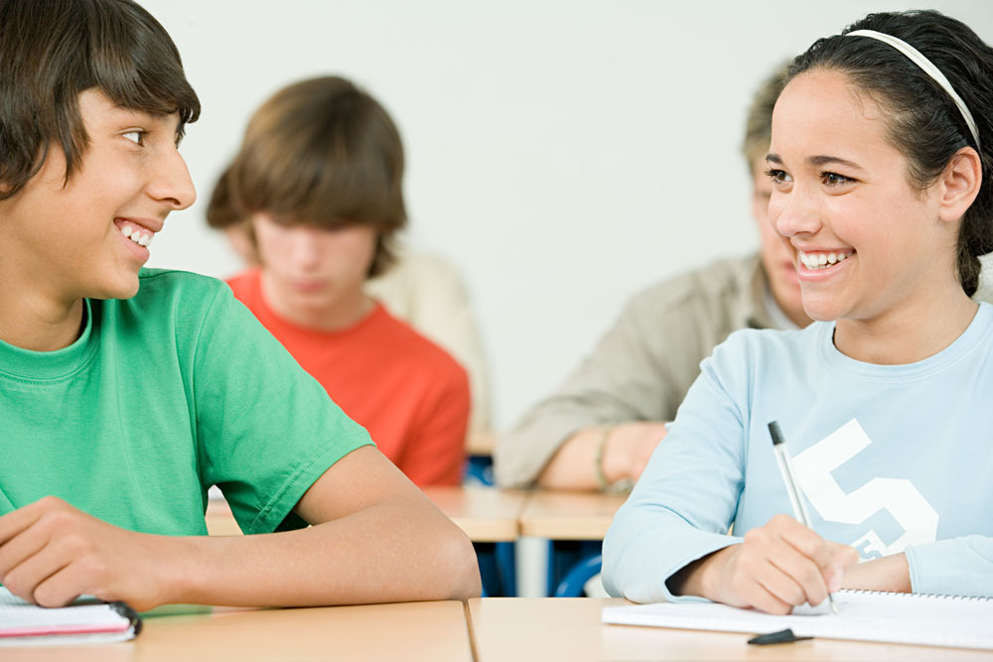
Unit 14
I remember meeting
all of you in Grade 7.

Slide 3



Slide 4


1. To learn the poem I remember.
2. To learn to find the rhyme of a poem.
3. To learn to use some words and expressions.

Slide 5

What do you remember about your life in junior high?
morning readings
New Year’s parties
I remember
sports day
preparing for exams

Slide 6

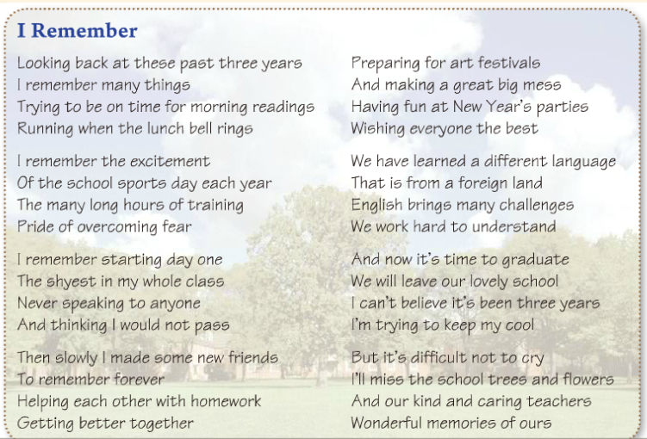
(诗的)节，段
英文诗每行第一个字母都大写
How many stanzas are there in it?
Eight.

Slide 7

诗歌小常识
1. 有的英文诗分成几节（stanza），每节由若干诗行组成；有的诗则不分节。
2. 诗每行的第一个字母都大写，但是一诗行不一定是一个完整的句子，不一定能表达完整的意思。有时一行诗正好是一句，有时两行甚至许多行才构成一个意思完整的句子。
3. 押韵。常见押韵：头韵指一行（节）诗中几个词开头的辅音相同。押在诗行最后一个重读音节上，叫尾韵。这是诗歌最常见的押韵部位。诗行中间停顿处的重读音节与该行最后一个重读音节押韵者，叫行内韵。也有不少是不押韵的，称无韵诗或白体诗。多用在戏剧和叙事诗中。

Slide 8
Scan the passage and match the main idea.
Main ideas | Stanzas
Experiences or memories about the past
Feelings about having to leave
1–6
7, 8

Slide 9
Read the passage. What activities can the writer remember about his or her life in junior high?
helping with homework
preparing for art festivals
making friends
New Year’s parties
morning readings
I remember
school trees and flowers, kind and caring teachers
sports day
starting day one
learning a language

Slide 10

3a
Read the passage and answer the questions.
1. What kind of writing is this?
2. What is the main subject of this writing?
This is a poem.
The main subject is the writer’s memories of school over the last three years.
3. Who do you think the writer is?
The writer is a student who is just about to graduate.

Slide 11
Read the poem (1-6 stanzas) and finish the diagram.
Stanzas | Experiences / Memories | Feelings
1
2
3
4
5
6
morning reading
school sports day,
long hours of training
pride of overcoming fear
starting day
shy
making friends, helping each other with homework
preparing for art festivals,
New Year’s parties
learning a different language

Slide 12
Read the poem (7-8 stanzas) and answer the following questions.
1) How does the writer feel about leaving
the school?
2) What will the writer miss?
He/she wants to cry.
The school trees and flowers, and kind and caring teachers.

Slide 13

Listen and find the rhyme.

Slide 14
Read the poem again. Write the words that rhyme with the words below.
3b
fear
things rings
year ________
pass
class ________
understand
land ___________
cool
ours
school ________
flowers ________

Slide 15
Have you experienced any of the following things? How did you feel? How does the writer feel about them?
3c
trying to be on time for morning readings
It was a struggle to be on time for morning readings.

Slide 16
2. running to the dining hall when the lunch bell rings
3. training for sports day
He/ She was hungry so he/she rushed to the dining hall when the bell rang.
He/ She was excited about training and proud when he/ she overcame his/her fears.

Slide 17
4. starting the first day in Grade 7
5. slowly making some new friends
6. helping classmates with homework
He/ She was shy when starting his/her first day in Grade 7.
He/ She felt it was a little difficult to make friends.
He/ She was happy helping classmates with homework.

Slide 18
7. preparing for art festivals
8. going to New Year’s parties
9. learning English
He/ She enjoyed preparing for art festivals (with his/ her friends) and making a great big mess.
He/ She had fun at New Year’s parties.
There were many challenges that the writer and his / her friends had to work hard to understand.

Slide 19
Competition
朗读诗歌，比比看谁朗读得最好。

Slide 20


1. Looking back at these past three years
回顾过去三年时光
look back at 回顾
e.g. Every time I look back at my childhood, I cannot help missing my dear grandma.
每当回忆童年生活，我总是忍不住想念我亲爱的祖母。

Slide 21

2. Trying to be on time for morning readings
尽力按时赶上早读
on time | 准时，按时
in time | 及时

Slide 22
【语境应用】用in time或on time填空。
1) We students should go to school
________.
2) The doctor came _______ and saved
the little boy’s life.
on time
in time

Slide 23
3. The many long hours of training
pride of overcoming fear
长时间的运动训练让我克服恐惧
自豪之情充满胸膛
overcome 克服；战胜
e.g. They overcame all kinds of difficulties and completed the task.
他们克服了各种困难完成了任务。

Slide 24
4. I’m trying to keep my cool
我尽力让自己保持冷静
keep one’s cool 保持沉着；不让自己失去控制, cool用作名词。
e.g. “I must keep my cool,” she thought,
“Losing my temper isn’t going to help.”
她想：“我要保持冷静，发脾气是不
会起作用的。”

Slide 25
5. And our kind and caring teachers
还有那些善良体贴的老师们
caring adj. 体贴人的；关心他人的
e.g. I've always thought of Jo as a very
caring person.
我一直认为乔是个很有爱心的人。

Slide 26


回首(往事)；回忆；回顾
早读
学校体育节
长时间的训练
克服恐惧
为……做准备
艺术节
弄得一团糟
look back at
morning readings
school sports day
long hours of training
overcome fears
prepare for…
art festival
make a mess

Slide 27


Ⅰ. 根据语境及所给首字母提示，补全所缺单词。
1. —Will our football team win first place?
—I think so. O is much stronger
than the others'.
2. My sister didn't take up rock climbing until
she o her fear of heights.
3. I have never seen my classmate Sue since we
g from senior high school in 2001.
Ours
overcame
graduated

Slide 28
Ⅱ. 根据汉语意思完成英语句子，每空一词。
1. 大家都沉住气！警察正在来商场的路上。
__________ __________ __________,
everyone! The police are on their way to the
mall.
2. 星期三曼迪将会帮助我准备晚会。
Mandy will help me __________ __________
the party on Wednesday.
Keep your cool
prepare for

Slide 29
3. 如果我在卧室弄得一团糟我妈妈会生气。
My mom will be mad at me if I
__________ __________ __________ in the
bedroom.
4. 随着时间的逝去，爱因斯坦的理论证明是
正确的。
As time __________ __________,
Einstein's theory proved to be correct.
make a mess
went by

Slide 30
5. 在老师的帮助下，凯西在这次比赛中获得
了第一名。
__________ __________ __________
__________, Cathy came first in the
competition.
6. 布莱克老师是如此的和蔼体贴以致所有的
学生都喜欢她。
Mrs. Black is such a(n) __________
__________ __________ __________ that
all the students like her.
With her teacher's
help
kind
and caring teacher

Slide 31
7. 当你在以后的日子里回忆你的生活时，你
会发现你和家人以及朋友一起度过的日子
是最美好的。
When you ________ ________ ________
your life in your later years, you'll find that
the time you spent with your family and
friends was the best.
look back at

Slide 32


1. Read the poem after class.
2. Remember the new words.
3. Preview the Grammar Focus.

Slide 33


